Slide 1
Exam 2 DC Circuits
Ch 24-26

Slide 2
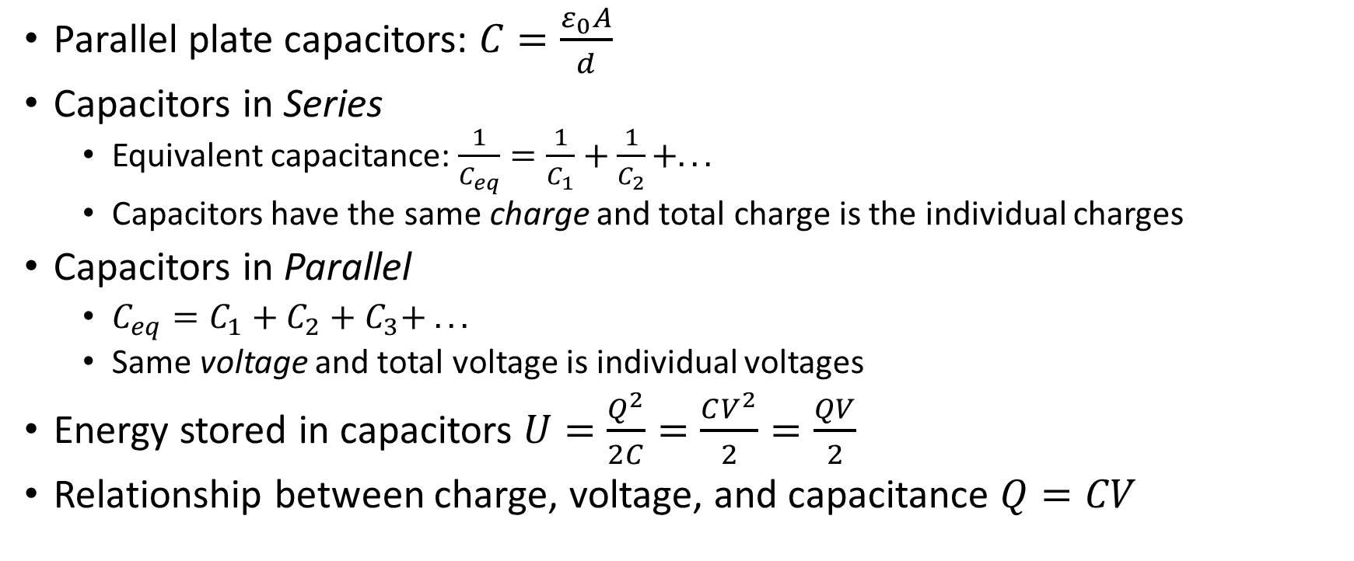
Ch 24 Capacitors
Parallel plate capacitors: $C=\frac{ε_{0}A}{d}$
Capacitors in Series
Equivalent capacitance: $\frac{1}{C_{eq}}=\frac{1}{C_{1}}+\frac{1}{C_{2}}+. . .$
Capacitors have the same charge and total charge is the individual charges
Capacitors in Parallel
$C_{eq}=C_{1}+C_{2}+C_{3}+ . . .$
Same voltage and total voltage is individual voltages
Energy stored in capacitors $U=\frac{Q^{2}}{2C}=\frac{CV^{2}}{2}=\frac{QV}{2}$
Relationship between charge, voltage, and capacitance $Q=CV$

Slide 3

Ch 25 Current, Resistance, & EMF (Voltage)
$V=IR$, $ε=V$
$R=\frac{ρL}{A}$
$J=\frac{I}{A}=nqv_{d}$
KVL: $ΔV=0=Σ(V−IR)$
$P=IV=I^{2}R=\frac{V^{2}}{R}$

Slide 4
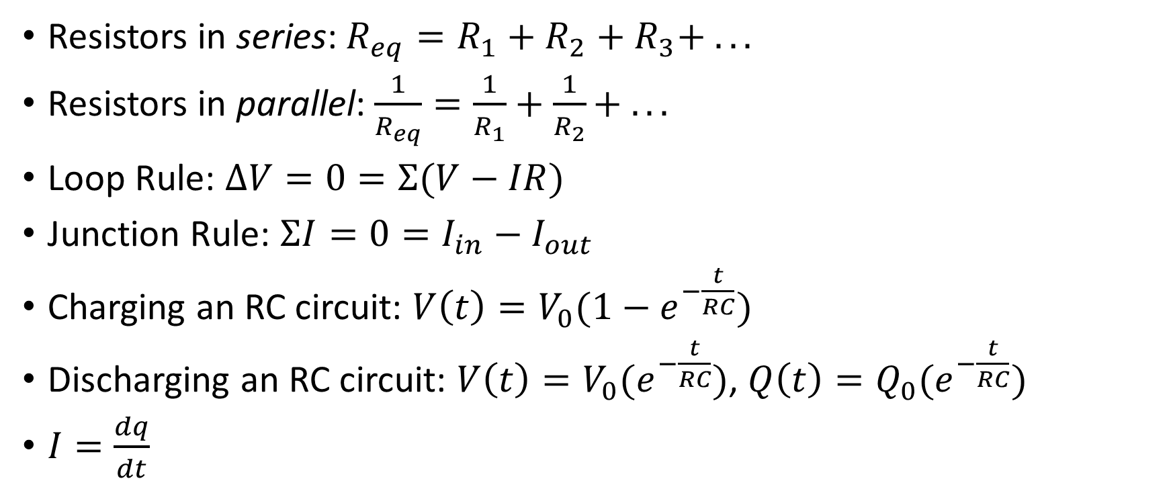
Ch 26 Resistor-Capacitor Circuits
Resistors in series: $R_{eq}=R_{1}+R_{2}+R_{3}+ . . .$
Resistors in parallel: $\frac{1}{R_{eq}}=\frac{1}{R_{1}}+\frac{1}{R_{2}}+ . . .$
Loop Rule: $ΔV=0=Σ(V−IR)$
Junction Rule: $ΣI=0=I_{in}−I_{out}$
Charging an RC circuit: $V\left(t\right)=V_{0}(1−e^{−\frac{t}{RC}})$
Discharging an RC circuit: $V\left(t\right)=V_{0}(e^{−\frac{t}{RC}})$, $Q\left(t\right)=Q_{0}(e^{−\frac{t}{RC}})$
$I=\frac{dq}{dt}$

